Slide 1


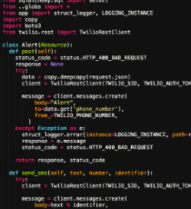
Automated Data Center
Dircks Physical Ticket
Beltmann Database
Design Database Structure
Data Input
Data Manipulation
Build Data pipeline through API
Text Mining
Data Visualization
Automation
Prediction
Machine Leaning
Daniel Database

Slide 2
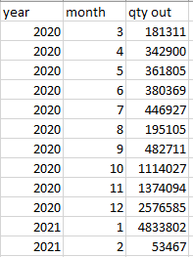

Slide 3
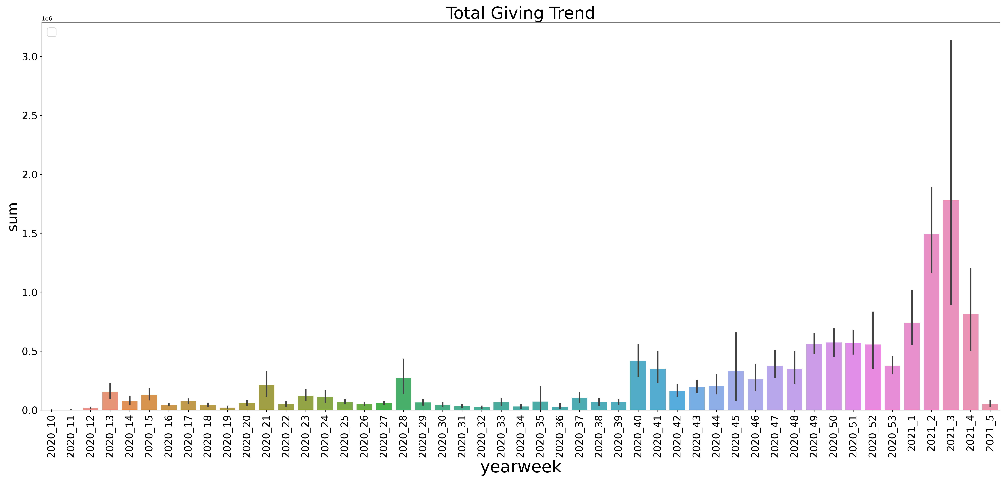

Slide 4
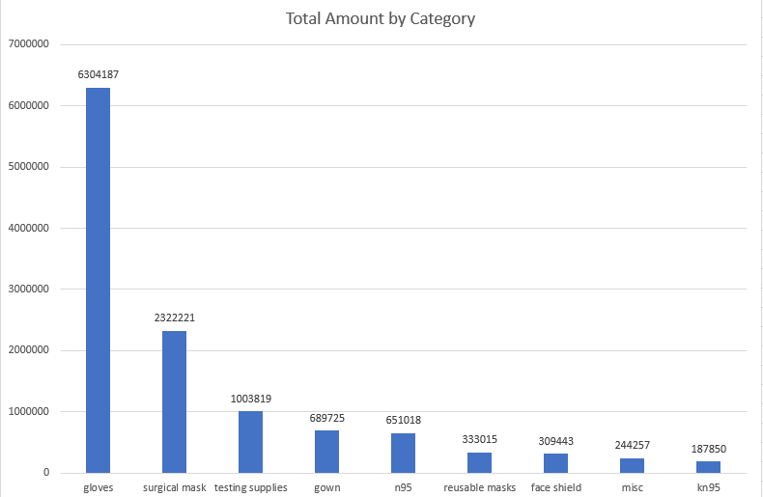
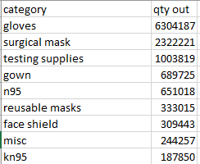

Slide 5
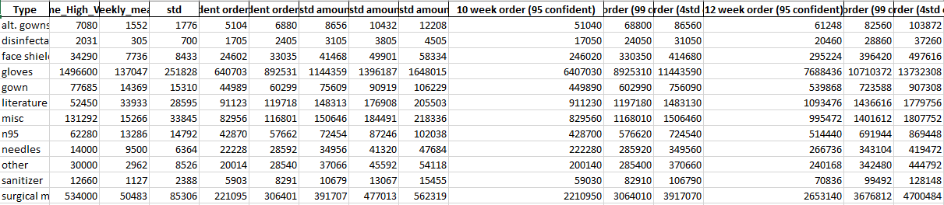

Slide 6
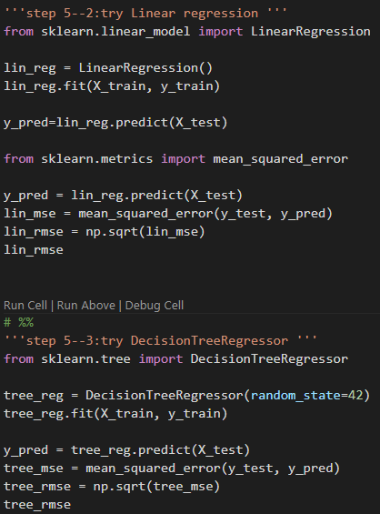
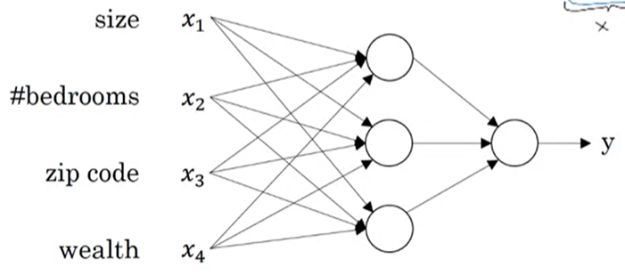
ML Failed, Data feature is not descriptive

